Slide 1
Module 1
Deploying and Managing Windows Server 2012
Notes:
Presentation: 100 minutes
Lab: 75 minutes
After completing this module, students should be able to:
Describe Windows Server® 2012.
Install Windows Server 2012.
Perform post‑installation configuration of Windows Server 2012.
Describe the management tools available in Windows Server 2012.
Perform basic administrative tasks with Windows PowerShell®.
Required Materials
To teach this module, you need the Microsoft® Office PowerPoint® file 20410D_01.pptx.
Important: We recommend that you use Office PowerPoint 2007 or a newer version to display the slides for this course. If you use PowerPoint Viewer or an older version of Office PowerPoint, all the features of the slides might not display correctly.
Preparation Tasks
To prepare for this module:
Read all of the materials for this module.
Practice performing the lab exercises.
Work through the Module Review and Takeaways section, and determine how you will use this section to reinforce student learning and promote knowledge transfer to on‑the‑job performance.
20410D
1: Deploying and Managing Windows Server 2012

Slide 2
Module Overview
Windows Server 2012 Overview Installing Windows Server 2012 Post-Installation Configuration of Windows Server 2012 Overview of Windows Server 2012 Management Introduction to Windows PowerShell
Notes:
This module introduces students to the editions of Windows Server 2012 and the new Windows Server 2012 management tools; and teaches them how to install Windows Server 2012, how to perform post-deployment tasks, and how to perform basic administrative tasks.
Point out to students that, in this course, references to Windows Server 2012 mean both Windows Server and Windows Server 2012 R2. If Windows Server 2012 R2 is specifically mentioned, the reference is only for Windows Server 2012 R2 (for example, for upgrades).
20410D
1: Deploying and Managing Windows Server 2012

Slide 3
Lesson 1: Windows Server 2012 Overview
Windows Server 2012 R2 Editions What Is Server Core? Windows Server 2012 R2 Roles What Are the Windows Server 2012 Features?
Notes:
20410D
1: Deploying and Managing Windows Server 2012

Slide 4
Windows Server 2012 R2 Editions
Windows Server 2012 editions:
Windows Server 2012 R2 Standard
Windows Server 2012 R2 Datacenter
Windows Server 2012 R2 Foundation
Windows Server 2012 R2 Essentials
Microsoft Hyper-V Server 2012 R2
Windows Storage Server 2012 R2 Workgroup
Windows Storage Server 2012 R2 Standard
Windows MultiPoint Server 2012 Standard
Windows MultiPoint Server 2012 Premium
Notes:
Describe for students the type of environment in which they would deploy each edition, and why they should not use the Windows Server 2012 R2 Standard edition as a “one size fits all” solution. Ensure that they understand the difference between the standard and datacenter editions.
20410D
1: Deploying and Managing Windows Server 2012

Slide 5
What Is Server Core?
Server Core:
Is a more secure, less resource-intensive installation option
Can be converted to full graphical shell version of Windows Server 2012
Is the default installation option for Windows Server 2012
Is managed locally using sconfig.cmd
With remote management enabled, you rarely will need to sign in locally
Notes:
Inform students that they can run remote administration tools from client computers that are running appropriate editions of the Windows® 7 and Windows 8.1 operating systems.
20410D
1: Deploying and Managing Windows Server 2012

Slide 6
Windows Server 2012 R2 Roles
Roles
Roles are made up of role services components that provide additional functionality associated with the role
In Server Manager 2012, console servers with a similar role are grouped together
Role deployment also includes the configuration of dependencies
Notes:
Ask students about roles that are commonly deployed on their network. Ask which roles they deploy often, and which roles they are unlikely to deploy.
Mention the roles that have been deprecated in Windows Server 2012 R2.
Question
Which roles are often co‑located on the same server?
Answer
Answers might vary. Domain Name System (DNS) and Active Directory® Domain Services (AD DS) are often co‑located.
20410D
1: Deploying and Managing Windows Server 2012

Slide 7
What Are the Windows Server 2012 Features?
Features:
Are components that support the server such as Windows Server Backup or Failover clustering
Usually do not provide a service directly to clients on the network
Keep in mind the following points:
Roles can have features as dependencies
Features on Demand are features that need to be installed using a mounted image as a source
Notes:
Choose several features to point out and discuss. For example, point out that you need to install the Wireless LAN Service to use a wireless adapter with Windows Server 2012. Also point out that by default, no roles and features are installed. Mention the features that have been removed or deprecated.
Question
Which feature do you need to install to support NetBIOS name resolution for client computers running a Microsoft Windows NT® 4.0 operating system workstation?
Answer
You need to install the Windows Internet Name Service (WINS) server role to support NetBIOS name resolution.
20410D
1: Deploying and Managing Windows Server 2012

Slide 8
Lesson 2: Installing Windows Server 2012
Installation Methods Installation Types Choosing Whether to Upgrade or Migrate Hardware Requirements for Windows Server 2012 R2 Installing Windows Server 2012 Migrating Server Roles
Notes:
20410D
1: Deploying and Managing Windows Server 2012

Slide 9







Installation Methods
Windows Server 2012 R2 deployment method options include:
Optical disk
USB flash drive
Windows Deployment Services
Notes:
Ask students which deployment method they most frequently use in their organization. Answers are likely to differ between clients and servers. Ask if they have already deployed Windows Server 2012, and if so, which method they used.
Question
What is another method that you can use to deploy Windows Server 2012 ?
Answer
You can also configure Windows Server 2012 to boot to either a .vhd or a .vhdx file. Deployment involves copying the .vhd file to a computer, either from a network share or from local media.
20410D
1: Deploying and Managing Windows Server 2012

Slide 10
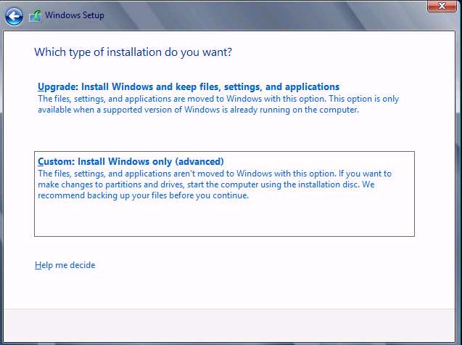
Installation Types
Notes:
20410D
1: Deploying and Managing Windows Server 2012

Slide 11


Choosing Whether to Upgrade or Migrate
In-place upgrade
Advantages: | Disadvantages:
Generally straightforward process that takes less time and planning than a migration strategy All server roles, features, data, and application settings are maintained | More difficult to troubleshoot installation failures caused by existing applications or server roles Existing problems and configuration issues might be brought into the new operating system
Migration
Advantages: | Disadvantages:
Easier to troubleshoot installation failures Existing configuration or application issues are not carried forward to the new operating system You can easily move to updated versions of applications | Requires all applications to be reinstalled and configured Requires planning of migration of server roles Requires migration of data Requires the purchase of new hardware
Notes:
Point out that clean installs and migrations are generally the preferred method of upgrading operating systems. Even though they are more time consuming, there is usually less troubleshooting involved, especially when you are dealing with systems that have been in production for a long time and have gone through many configuration changes.
20410D
1: Deploying and Managing Windows Server 2012

Slide 12
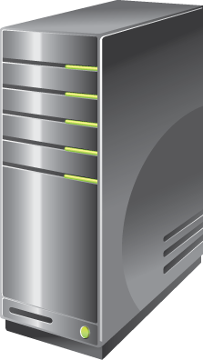
Hardware Requirements for Windows Server 2012 R2
Windows Server 2012 R2 has the following minimum hardware requirements:
Processor architecture x64
Processor speed 1.4 GHz
Memory (RAM) 512 MB
Hard disk drive space 32 GB
More hard disk drive space is needed if the server has more than 16 GB of RAM
Notes:
Remind students that the minimum hardware requirements apply to the operating system itself, and do not include any applications that they might want to deploy on the operating system. Hardware requirements also vary depending on the server role. For example, a SQL Server database server requires a more powerful processor and more RAM than a server that functions as a file server.
Question
Why does a server need more hard disk drive space if it has more than 16 GB of RAM?
Answer
A server needs more hard disk drive space because it requires additional hard disk space for virtual memory.
20410D
1: Deploying and Managing Windows Server 2012

Slide 13
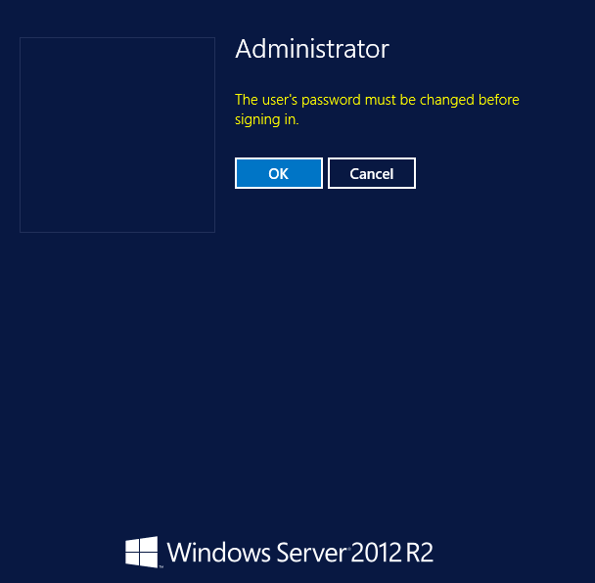
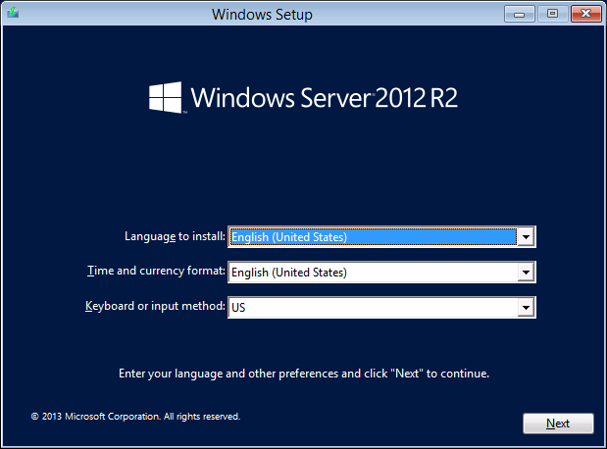
Installing Windows Server 2012
Notes:
Slide 1 of 7: Choose installation language, currency format, time format, and keyboard input method.
There are seven slides for this topic. None have actual animations.
Use these slides to demonstrate each part of the Windows Server 2012 R2 installation process.
Reinforce that only a few decisions need to be made to deploy Windows Server 2012 R2.
Remind students that in almost all cases they will use the Custom rather than the Upgrade installation option.
Remind students that upgrades must be launched from within the Windows Server operating system, but that they can launch a fresh installation from bootable media.
The seven separate slides illustrate the Windows Server 2012 R2 installation steps:
Slide 1: Choose installation language, currency format, time format, and keyboard input method.
Slide 2: Click Install Now, or choose to repair your computer.
Slide 3: Select the operating system that you want to install.
Slide 4: Review and accept the license terms.
Slide 5: Select the installation type, Upgrade or Custom.
Slide 6: Select the installation location.
Slide 7: Provide the password for the local administrator account.
20410D
1: Deploying and Managing Windows Server 2012

Slide 14
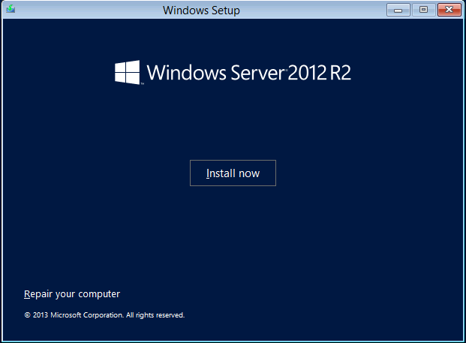
Installing Windows Server 2012
Notes:
Slide 2 of 7: Click Install Now, or choose to repair your computer.
20410D
1: Deploying and Managing Windows Server 2012

Slide 15
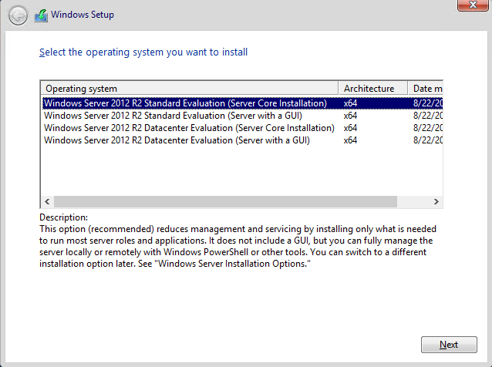
Installing Windows Server 2012
Notes:
Slide 3 of 7: Select the operating system you want to install.
20410D
1: Deploying and Managing Windows Server 2012

Slide 16
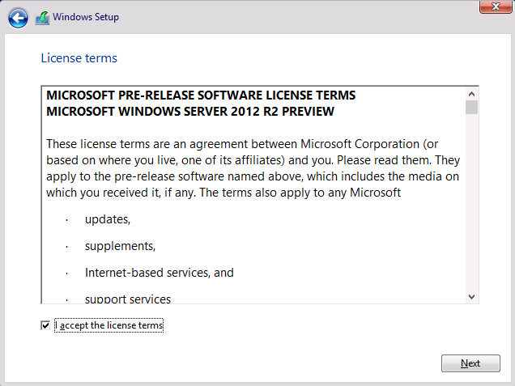
Installing Windows Server 2012
Notes:
Slide 4 of 7: Review and accept the license terms.
20410D
1: Deploying and Managing Windows Server 2012

Slide 17
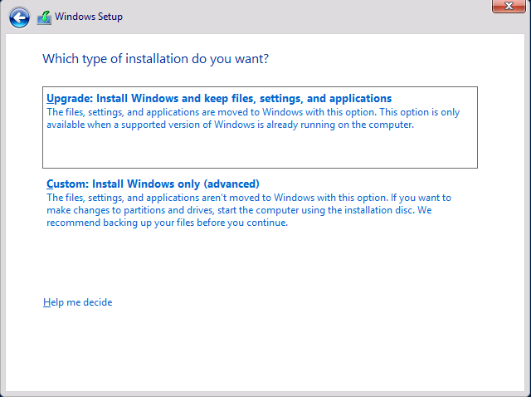
Installing Windows Server 2012
Notes:
Slide 5 of 7: Select the installation type, Upgrade or Custom.
20410D
1: Deploying and Managing Windows Server 2012

Slide 18
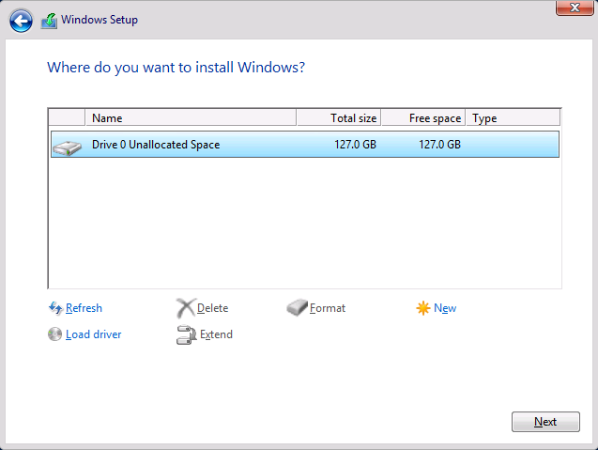
Installing Windows Server 2012
Notes:
Slide 6 of 7: Select the installation location.
20410D
1: Deploying and Managing Windows Server 2012

Slide 19
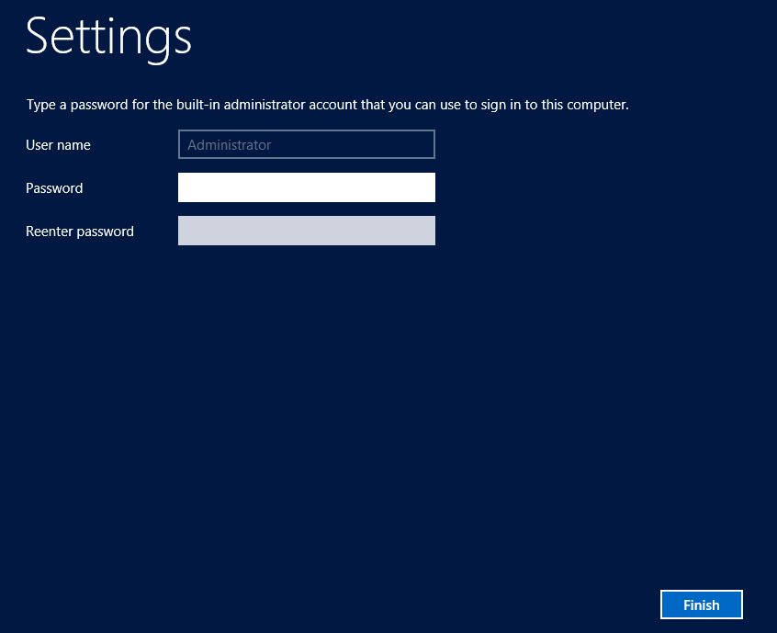
Installing Windows Server 2012
Notes:
Slide 7 of 7: Provide the password for the local administrator account.
20410D
1: Deploying and Managing Windows Server 2012

Slide 20
Migrating Server Roles
Windows Server Migration Tools assist in the migration process
Microsoft provides the following guides to assist in migration of roles and services:
Migrate Active Directory Federation Services Role Services to Windows Server 2012
Migrate Health Registration Authority to Windows Server 2012
Migrate Hyper-VDI to Windows Server 2012
Migrate IP Configuration to Windows Server 2012
Migrate Network Policy Server to Windows Server 2012
Migrate Print and Document Services to Windows Server 2012
Migrate Remote Access to Windows Server 2012
Migrate Windows Server Update Services to Windows Server 2012
Notes:
Point out that not every role can be migrated. For example, the Active Directory Domain Services (AD DS) role cannot be migrated. Typically, a new domain controller is created and the old one is decommissioned.
Also point out that migration guides exist for migrating roles to Windows Server 2008 R2, and that the guidance in those guides still applies.
20410D
1: Deploying and Managing Windows Server 2012

Slide 21
Lesson 3: Post-Installation Configuration of Windows Server 2012
Overview of Post-Installation Configuration Configuring Server Network Settings How to Join a Domain Activating Windows Server 2012 Configuring a Server Core Installation Demonstration: Using DISM to Add Windows Features
Notes:
20410D
1: Deploying and Managing Windows Server 2012

Slide 22
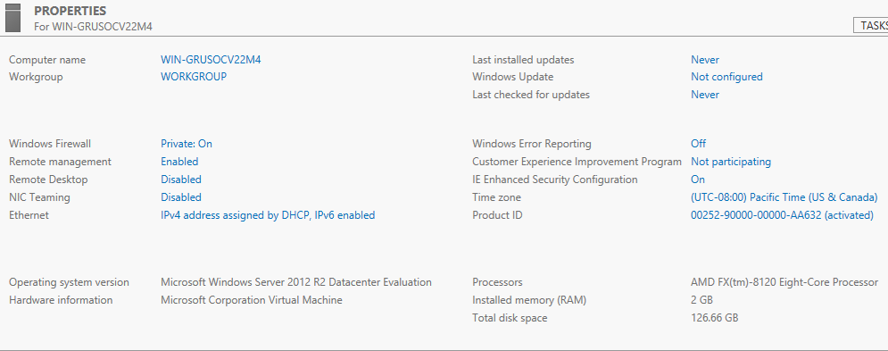
Overview of Post-Installation Configuration
Notes:
Slide 1 of 8
Use this set of eight slides to discuss the properties shown:
Slide 1: All properties
Slide 2: Computer name
Slide 3: Domain
Slide 4: Windows Firewall
Slide 5: Remote Desktop
Slide 6: Local Area Connection
Slide 7: These three together: Last installed updates, Windows Update, Last checked for updates
Slide 8: Time zone
20410D
1: Deploying and Managing Windows Server 2012

Slide 23
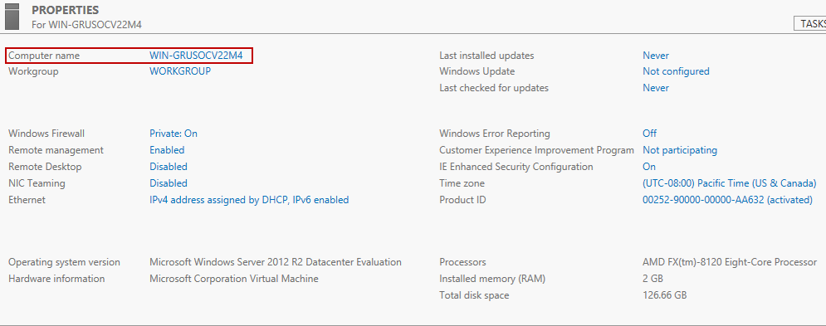
Overview of Post-Installation Configuration
Notes:
Slide 2 of 8: Computer name
20410D
1: Deploying and Managing Windows Server 2012

Slide 24
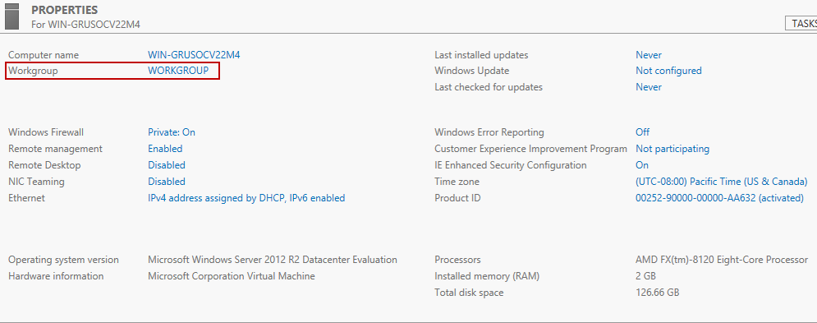
Overview of Post-Installation Configuration
Notes:
Slide 3 of 8: Domain or Workgroup
20410D
1: Deploying and Managing Windows Server 2012

Slide 25
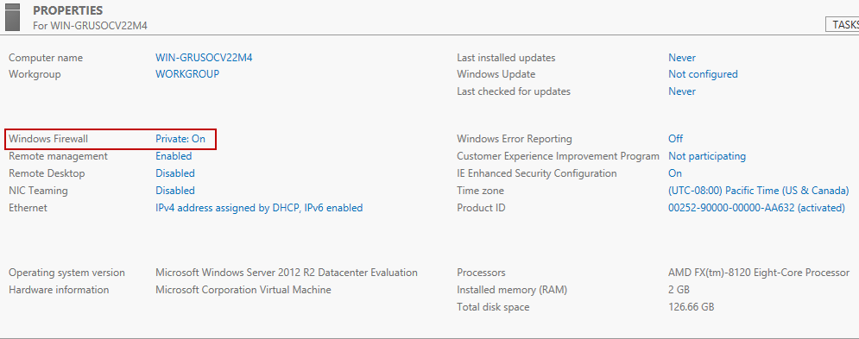
Overview of Post-Installation Configuration
Notes:
Slide 4 of 8: Windows Firewall status
20410D
1: Deploying and Managing Windows Server 2012

Slide 26
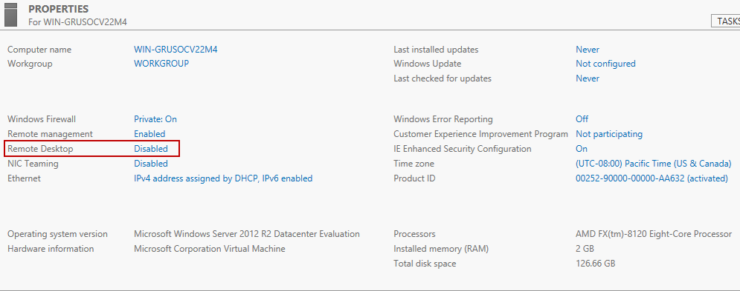
Overview of Post-Installation Configuration
Notes:
Slide 5 of 8: Remote Desktop
20410D
1: Deploying and Managing Windows Server 2012

Slide 27
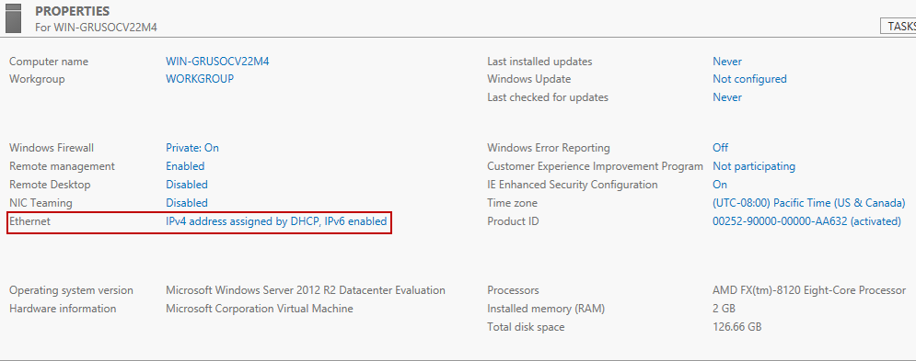
Overview of Post-Installation Configuration
Notes:
Slide 6 of 8: Local Area Connection
20410D
1: Deploying and Managing Windows Server 2012

Slide 28
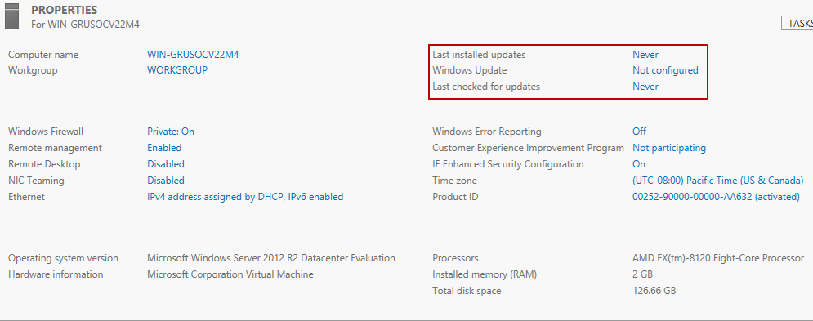
Overview of Post-Installation Configuration
Notes:
Slide 7 of 8: Shows these three together: Last installed updates, Windows Update, Last checked for updates
20410D
1: Deploying and Managing Windows Server 2012

Slide 29
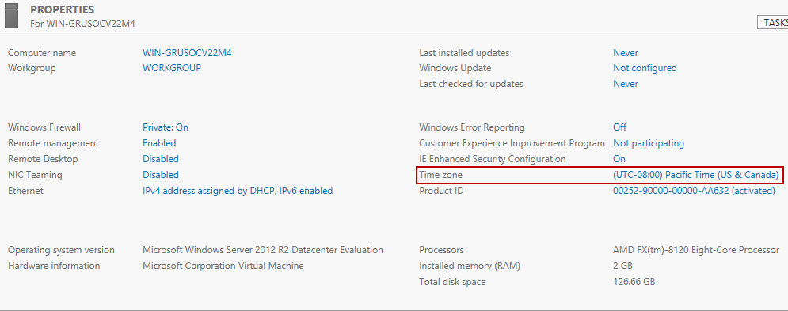
Overview of Post-Installation Configuration
Notes:
Slide 8 of 8: Time zone
20410D
1: Deploying and Managing Windows Server 2012

Slide 30
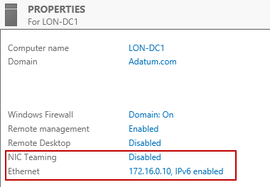
Configuring Server Network Settings
Notes:
Refer to the slide, which shows a screen shot of the local server node for the Server Manager console. In the local server node, the Local Area Connection and IP address display. Also note that the Network adapter teaming status appears.
20410D
1: Deploying and Managing Windows Server 2012

Slide 31
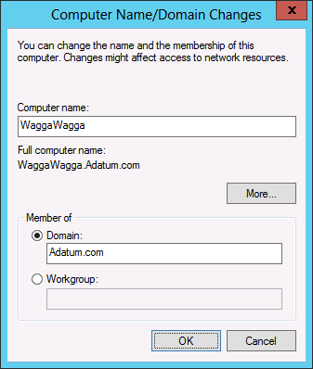
How to Join a Domain
Information necessary for a domain join:
Domain name
Account with permission to join the computer to the domain
Notes:
Display the Computer Name/Domain Changes dialog box, and review the list of information necessary for domain join.
20410D
1: Deploying and Managing Windows Server 2012

Slide 32
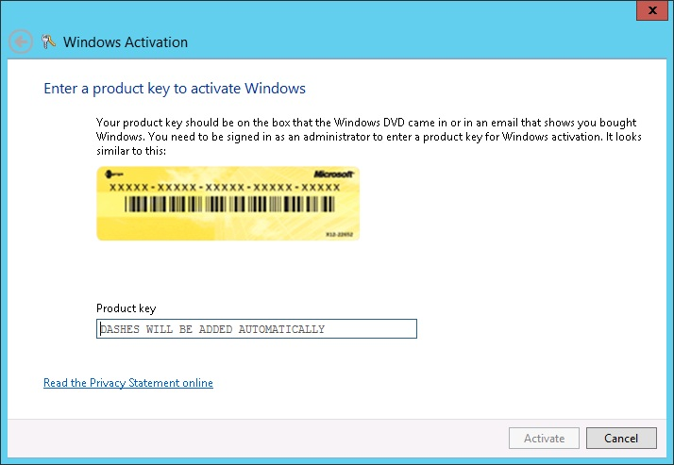
Activating Windows Server 2012
Notes:
Discuss the traditional activation process. Ask students about the last time they performed a telephone activation. Ask them if they have ever had any problems with activation, and if so, how they resolved the problem. Ask if they use any automatic activation technologies in their environment.
20410D
1: Deploying and Managing Windows Server 2012

Slide 33
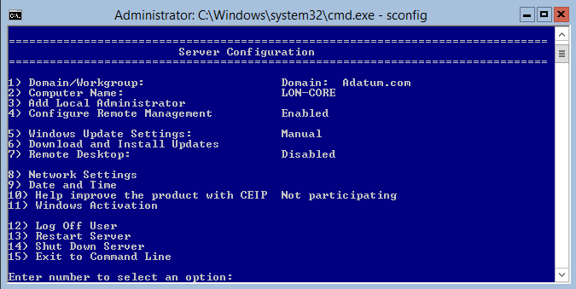
Configuring a Server Core Installation
Notes:
Discuss the functionality of sconfig.cmd.
Sconfig is a menu‑driven command‑line tool that presents menu options in a numerical format. Administrators can run commands and perform configurations based on the numbered menu options.
This tool simplifies the process of performing common basic administrative tasks on Server Core, which was a problem for many administrators with the Server Core version that was available with Windows Server 2008 because you needed to know the correct commands.
20410D
1: Deploying and Managing Windows Server 2012

Slide 34
Demonstration: Using DISM to Add Windows Features
In this demonstration, you see how to use the DISM command-line utility to:
View a list of all Windows features and their current state
Gather information about the Windows Server Backup feature
Enable the Windows Server Backup feature
Notes:
Emphasize that the feature names are case-sensitive when you use the DISM utility.
Preparation Steps
For this demonstration, start the 20410D-LON-DC1 virtual machine.
Sign in as Adatum\Administrator with the password Pa$$w0rd.
Demonstration Steps
View a list of all Windows features and their current state
1. In Server Manager click the Tools menu, and then click Windows Server Backup.
In the details pane, notice that Windows Server Backup is not installed on the computer.
2. Close the wbadmin-[Windows Server Backup(Local)] window.
Gather information about the Windows Server Backup feature
Right-click the Windows PowerShell icon on the taskbar, and then click Run as Administrator.
Type the following command, and then press Enter:
DISM /online /get-features
3. Type the following command, and then press Enter:
DISM /online /get-featureinfo /featurename:WindowsServerBackup
Enable the Windows Server Backup feature
Type the following command, and then press Enter:
DISM /online /enable-feature /featurename:WindowsServerBackup
Note: The feature name is case-sensitive.
In Server Manager, click the Tools menu, and then click Windows Server Backup.
In the details pane, notice that Windows Server Backup is now available.
3. Close all open windows.
20410D
1: Deploying and Managing Windows Server 2012

Slide 35
Lesson 4: Overview of Windows Server 2012 Management
What Is Server Manager? Administrative Tools and Remote Server Administration Tools Demonstration: Using Server Manager Configuring Services Configuring Windows Remote Management Demonstration: Performing Remote Management
Notes:
Briefly present the lesson content.
20410D
1: Deploying and Managing Windows Server 2012

Slide 36







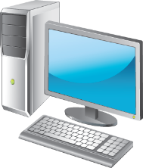



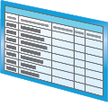
What Is Server Manager?
You can use Server Manager to:
Manage multiple servers on a network from one console
Add roles and features
Launch Windows PowerShell sessions
View events
Perform server configuration tasks
Manage down-level servers
You can use Best Practices Analyzer to:
Determine whether roles on your network are functioning efficiently
Query event logs for warning and error events
Diagnose health issues with specific roles
Notes:
Demonstrate different Server Manager windows to illustrate the bulleted points on the slide.
20410D
1: Deploying and Managing Windows Server 2012

Slide 37
Administrative Tools and Remote Server Administration Tools
Administrative tools:
Active Directory Administrative Center
Active Directory Users and Computers
DNS console
Event Viewer
Group Policy Management Console
IIS Manager
Performance Monitor
Resource Monitor
Task Scheduler
Can be used to manage non-domain joined systems
Notes:
Describe each administrative tool and its function.
20410D
1: Deploying and Managing Windows Server 2012

Slide 38
Demonstration: Using Server Manager
In this demonstration, you will see how to:
Add a feature by using the Add Roles and Features Wizard
View role-related events
Run the Best Practice Analyzer for a role
List the tools available from Server Manager
Restart Windows Server 2012
Notes:
When you work through this demonstration, explain the purpose of each feature. Point out the following:
Although the visual style differs, many wizards have the same content.
When adding roles with Windows Server 2012, point out that any other necessary components will be added automatically.
When viewing DNS events, describe what would appear in these dialog boxes in the event that a DNS server was unhealthy.
Best Practices Analyzer only shows results if it has been run previously.
Explain how to pin particular consoles to the Start screen or to the taskbar.
Discuss other methods for shutting down the Windows Server 2012 server.
Preparation Steps
If necessary, start 20410D‑LON‑DC1.
Sign in as Adatum\Administrator with the password Pa$$w0rd.
Demonstration Steps
Add a feature by using the Add Roles and Features Wizard
In the Server Manager console, click Manage, and then click Add Roles and Features.
In the Add Roles and Features Wizard, on the Before you begin page, click Next.
On the Select installation type page, select Role‑based or featured‑based installation, and then click Next.
On the Select destination server page, click Select a server from the server pool, verify that LON‑DC1.Adatum.com is selected, and then click Next.
On the Select server roles page, select Fax Server.
In the Add Roles and Features Wizard dialog box that opens, click Add Features.
On the Select server roles page, click Next.
On the Select features page, select BranchCache, and then click Next.
On the Fax Server page, click Next.
20410D
1: Deploying and Managing Windows Server 2012
(More notes on the next slide)

Slide 39
Notes:
On the Print and Document Services page, click Next.
11. On the Select role services page, click Next.
12. On the Confirmation page, select the Restart the destination server automatically if required check box, click Yes, and then click Install.
13. On the Installation progress page, click Close.
14. Click the flag icon next to Server Manager Dashboard, and review the messages.
You can close this console without terminating the task.
View role‑related events
In the Server Manager console, click the Dashboard node.
In the Roles and Server Groups area, under DNS, click Events.
In the DNS ‑ Events Detail View dialog box, change the time period to 12 hours and the Event Sources to All, and then click OK.
Run the Best Practice Analyzer for a role
In the Roles and Server Groups area, under DNS, click BPA results.
In the DNS ‑ BPA Results Detail View dialog box, click the Severity Levels drop‑down menu, click All, and then click OK.
List the tools available in Server Manager
In the Server Manager console, click the Tools menu, and review the tools that are installed on LON‑DC1.
Press the Windows logo key to open the Start menu.
Sign out the currently signed‑in user
In the Start screen, click Administrator, and then click Sign Out.
Sign back in to LON‑DC1 using the Adatum\Administrator account and the password Pa$$w0rd.
Restart Windows Server 2012
1. On the taskbar, click the Windows PowerShell icon.
2. In the Windows PowerShell window, type the following command, and then press Enter:
Shutdown /r /t 5
20410D
1: Deploying and Managing Windows Server 2012

Slide 40
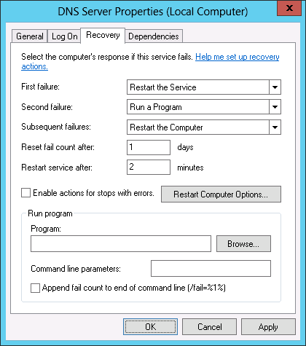
Configuring Services
Notes:
Discuss configuring service recovery, and why you should avoid having the service keep restarting.
Remind students to be careful with the option to restart the computer, because a service that keeps failing might trigger a cycle of restarting.
Discuss the benefits of managed service accounts over traditional service accounts. Ask students which method they currently use to manage service accounts.
The slide shows the properties of the DNS Server service, which is accessible from the Services console.
Question
What is the advantage of a managed service account compared to a traditional domain‑based service account?
Answer
The advantage of a managed service account is that you do not have to manage passwords for it.
20410D
1: Deploying and Managing Windows Server 2012

Slide 41
Configuring Windows Remote Management
When deciding to use Remote Management, consider the following:
You are more likely to manage a server remotely than by locally signing on
With WinRM, you can use consoles, command-line utilities, or Windows PowerShell to perform remote management tasks
With Remote Desktop, you can sign in to a server locally or from across the network
Notes:
Ask students how often they perform server management when they are signed in locally using a keyboard and mouse, compared to how often they perform remote server management.
Ask them which management technologies they use most frequently, and what the benefits and drawbacks are of these technologies.
20410D
1: Deploying and Managing Windows Server 2012

Slide 42
Demonstration: Performing Remote Management
In this demonstration, you will see how to:
Use Server Manager to manage a remote server
Add the DNS Server role on a remote server
Connect to and configure a remote server by using RDP
Notes:
Point out how to search for an app from the Start screen by starting to type the name of the app.
Preparation Steps
Ensure that 20410D-LON-DC1 is running.
Start 20410D-LON-SVR1.
Start 20410D-LON-CL1.
Demonstration Steps
Use Server Manager to manage a remote server
Sign in to LON-DC1 as Adatum\Administrator with the password Pa$$w0rd.
In the Server Manager Dashboard detail pane, click Add other servers to manage.
In the Add Servers dialog box, in the Name box, type LON-SVR1, and then click Find Now.
Select LON-SVR1, click the arrow to move it into the Selected pane, and then click OK.
Add the DNS Server role on a remote server
In the Server Manager Dashboard detail pane, click Add roles and features.
On the Before you begin page, click Next.
On the Select installation type page, click Next.
On the Select destination server page, click LON-SVR1.Adatum.com and click Next.
On the Select server roles page, select the DNS Server check box.
In the Add Roles and Features Wizard dialog box, click Add Features, and then click Next.
On the Select features page, click Next.
On the DNS Server page, click Next.
On the Confirm installation selections page, click Install, and then click Close.
20410D
1: Deploying and Managing Windows Server 2012
(More notes on the next slide)

Slide 43
Notes:
Connect to and configure a remote server by using RDP
Sign in to LON-SVR1 as Adatum\Administrator with the password Pa$$w0rd.
In Server Manager, click Local Server.
In the details pane, next to Remote Desktop, click Disabled.
In the System Properties dialog box, click Allow remote connections to this computer.
In the Remote Desktop Connection dialog box, click OK, and then click OK.
On LON-DC1, click the Start screen button in the lower-left corner.
Type Remote, and then click the Remote Desktop Connection icon.
In the Remote Desktop Connection dialog box, type LON-SVR1, and then click Connect.
Connect as Adatum\Administrator with the password Pa$$w0rd.
Sign out from LON-SVR1.
20410D
1: Deploying and Managing Windows Server 2012

Slide 44
Lesson 5: Introduction to Windows PowerShell
What Is Windows PowerShell? Windows PowerShell Cmdlet Syntax Common Cmdlets for Server Administration Demonstration: Using Windows PowerShell What Is Windows PowerShell ISE? Demonstration: Using Windows PowerShell ISE Windows PowerShell Desired State Configuration
Notes:
Briefly present the lesson content.
20410D
1: Deploying and Managing Windows Server 2012

Slide 45
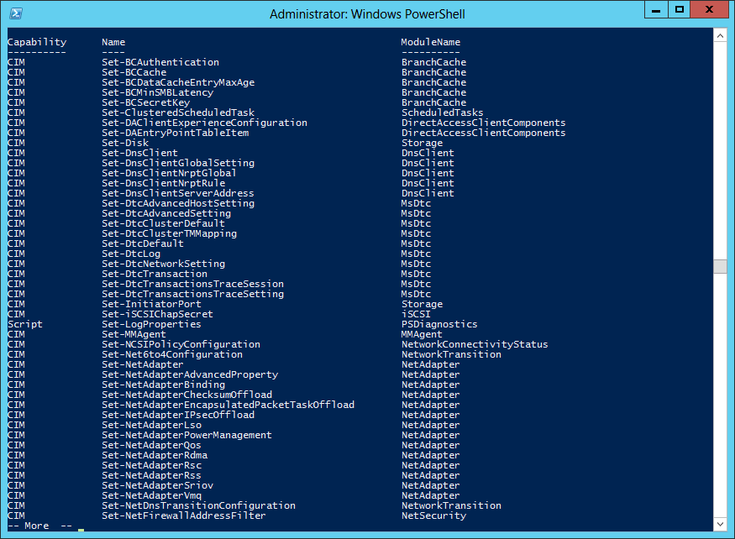
What Is Windows PowerShell?
Notes:
20410D
1: Deploying and Managing Windows Server 2012

Slide 46
Windows PowerShell Cmdlet Syntax
Windows PowerShell Cmdlet Syntax:
Get-Help -Noun NounName
Get-Help -Verb VerbName
Help CmdltName
Get-Command
Notes:
When you discuss Windows PowerShell, remind students that they should consider automating repetitive tasks because that will give them more time to perform non‑repetitive tasks. Students should try to automate any task that they need to perform more than a few times.
20410D
1: Deploying and Managing Windows Server 2012

Slide 47
Common Cmdlets for Server Administration
System Administration cmdlets | Details
Service Cmdlets | Use the Service noun
Event Log Cmdlets | Use the Eventlog noun
Process Cmdlets | Use the Process noun
ServerManager module | Allows the WindowsFeature noun
Windows PowerShell Remote Management | Allows cmdlets or scripts to be run on remote computers
Notes:
Discuss these common systems administration cmdlets. Discuss how these cmdlets can be used on both Server Core and full GUI servers, and explain that they are often quicker to use than opening the Services console, Task Manager, or the Add Roles and Features Wizard.
20410D
1: Deploying and Managing Windows Server 2012

Slide 48
Demonstration: Using Windows PowerShell
In this demonstration, you will see how to use Windows PowerShell to:
Display the running services and processes on a server
Connect to a remote computer to display all services and their current status
Invoke commands to multiple computers and display running processes
Notes:
When you perform this demonstration, explain the information that is displayed after executing each command. Explain how you could modify the commands to display different information.
Mention that Windows PowerShell cmdlets are not case-sensitive.
Point out that you must exit the remote Windows PowerShell session or the invoke-command cmdlets will fail.
Preparation Steps
If necessary, start 20410D‑LON‑DC1.
Sign in as Adatum\Administrator with the password Pa$$w0rd.
Start 20410D-LON-SVR1.
Sign in as Adatum\Administrator with the password Pa$$w0rd.
Demonstration Steps
Use Windows PowerShell to display the running services and processes on a server
1. On LON‑DC1, on the taskbar, click the Windows PowerShell icon.
2. At the Windows PowerShell prompt, type the following command, and then press Enter:
Get‑Service | where‑object {$_.status ‑eq "Running"}
3. To view all the commands that are related to managing services, at the Windows PowerShell prompt, type the following command, and then press Enter:
Get‑Command ‑Noun Service
4. To view a list of running possesses on the server, at the Windows PowerShell prompt, type the following command, and then press Enter:
Get‑Process
5. To view all the commands that are related to managing processes, at the Windows PowerShell prompt, type the following command, and then press Enter:
Get‑Help Process
20410D
1: Deploying and Managing Windows Server 2012
(More notes on the next slide)

Slide 49
Notes:
6. To view detailed information about the Start‑Process cmdlet, at the Windows PowerShell prompt, type the following command, and then press Enter:
Get‑Help ‑Full Start‑Process
7. Close the Windows PowerShell window.
8. On the taskbar, right‑click the Windows PowerShell icon, and then click Run as Administrator. Discuss with students why you might need to run a Windows PowerShell session using this option.
Use Windows PowerShell to connect to a remote computer and display all services and their current status
1. On LON-SVR1, click the Windows PowerShell icon on the taskbar to start Windows PowerShell.
2. At the Windows PowerShell prompt, type the following command, and then press Enter:
Enable-PSRemoting
3. Read the output, and respond to each of the ensuing prompts by pressing Enter (five times) to accept the default response of Yes.
4. Switch to LON-DC1, and then click the Windows PowerShell icon on the taskbar to start Windows PowerShell.
5. At a Windows PowerShell prompt, type the following commands, and press Enter after each one:
Enter-PSSession –Computername LON-SVR1
Get-Service
Exit-PSSession
6. View the resulting output.
Use Windows PowerShell to invoke commands to multiple computers and display running services
1. On LON-DC1, type the following command, and then press Enter:
Invoke-Command –computername LON-DC1, LON-SVR1 –Scriptblock {Get-Process}
2. Examine the output, and then close the Windows PowerShell window.
20410D
1: Deploying and Managing Windows Server 2012

Slide 50
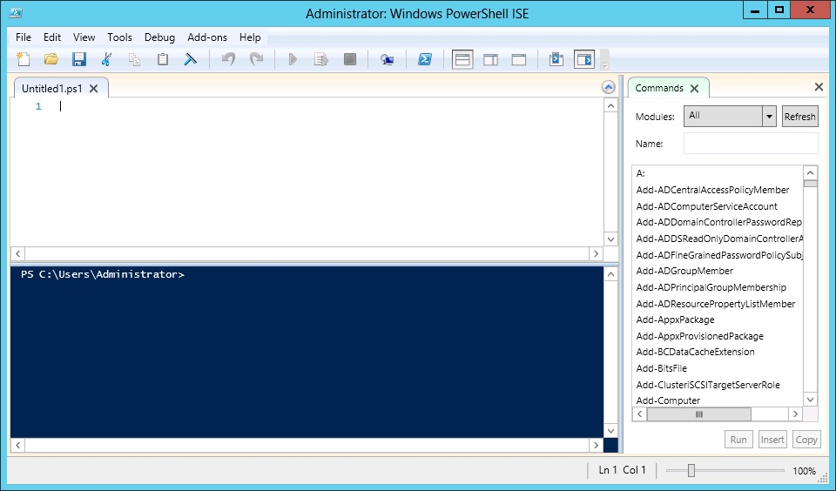
What Is Windows PowerShell ISE?
Notes:
Discuss the benefits of using the Windows PowerShell Integrated Scripting Environment (ISE) over using the normal Windows PowerShell window.
20410D
1: Deploying and Managing Windows Server 2012

Slide 51
Demonstration: Using Windows PowerShell ISE
In this demonstration, you will see how to:
Use Windows PowerShell ISE to import the ServerManager module
View the cmdlets made available in the ServerManager module
Use the Get-WindowsFeature cmdlet from Windows PowerShell ISE
Run a Windows PowerShell script from the scripting pane to create a universal group named Helpdesk and add members
Notes:
Point out the autocomplete capability that occurs as you type cmdlets.
Point out that the script runs the following three commands:
Imports the Active Directory module.
Creates a universal group named Helpdesk.
Populates the group based on the value of the Department field in the user properties.
Preparation Steps
1. If necessary, start 20410D‑LON‑DC1.
2. Sign in as Adatum\Administrator with the password Pa$$w0rd.
Demonstration Steps
Use Windows PowerShell ISE to import the ServerManager module
Ensure that you are signed in to LON‑DC1 as Administrator.
In Server Manager, click Tools, and then click Windows PowerShell ISE.
At the prompt, type Import‑Module ServerManager, and then press Enter.
This demonstrates the command-completion feature of the Windows PowerShell ISE.
View the cmdlets made available in the ServerManager module
In the Commands pane, use the Modules drop‑down menu to select the ServerManager module. Describe the function of the listed Windows PowerShell cmdlets.
Use the Get‑WindowsFeature cmdlet from Windows PowerShell ISE
Click Get‑WindowsFeature, and then click Show Details.
In the ComputerName field, type LON‑DC1, and then click Run.
Run a Windows PowerShell script from the scripting pane to create a universal group named Helpdesk and add members
1. In Server Manager, click Tools, and then click Active Directory Users and Computers.
2. Expand Adatum.com, and then click the IT organizational unit (OU). Note that there is no group named Helpdesk.
3. Use File Explorer to go to E:\Labfiles\Mod01, right-click CreateAndPopulateHelpdesk.ps1, and then click Edit.
This opens a new instance of Windows PowerShell ISE and exposes the scripting pane.
4. View the script, and then click the green arrow on the toolbar to run the script.
5. Switch back to Active Directory Users and Computers and refresh the view of the IT OU.
You should now see a group named Helpdesk.
6. Right-click the Helpdesk group and click Properties.
7. Click the Members tab.
You will see that the group is populated by the members of the IT department
8. Close all open windows.
20410D
1: Deploying and Managing Windows Server 2012

Slide 52
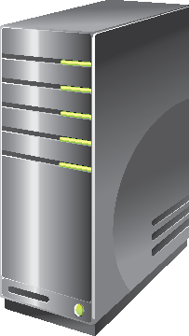
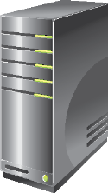

Windows PowerShell Desired State Configuration
Windows PowerShell DSC Push/Pull Model
Authoring Phase
Staging Phase
Implementation Phase
Configuration Files
PS V1, V2, V3
PS V4
Third-party languages and tools
Pull Model Server
Contains DSC data and modules
Local Configuration Store
Parser and Dispatcher
Imperative Providers
Configuration Files
PS V1, V2, V3
PS V4
Third-party languages and tools
Push Model Configuration Staging Area
Contains DSC data
Notes:
Using the illustration on the slide as a guide, explain the Windows PowerShell DSC Push/Pull model:
Configuration files are stored on either a Pull model server or a Push model server.
In the Pull model, the green arrow represents the configuration files being requested by the server being configured.
In the Push model, the blue arrow shows the one-way push of the configuration files to the server without a request.
20410D
1: Deploying and Managing Windows Server 2012

Slide 53
Lab: Deploying and Managing Windows Server 2012
Exercise 1: Deploying Windows Server 2012 Exercise 2: Configuring Windows Server 2012 Server Core Exercise 3: Managing Servers Exercise 4: Using Windows PowerShell to Manage Servers
Logon Information
Virtual machines 20410D‑LON‑DC1
20410D‑LON‑SVR3
20410D‑LON‑CORE
User name Adatum\Administrator
Password Pa$$w0rd
Estimated Time: 75 minutes
Notes:
Before the students begin the lab, read the lab scenario and display the next slide. Before each exercise, read the scenario associated with the exercise to the class. The scenarios give context to the lab and exercises, and help you facilitate the discussion at the end of the lab. Remind the students to complete the discussion questions after the last lab exercise.
Exercise 1: Deploying Windows Server 2012
The first Windows Server 2012 server that you are installing for the Marketing department will host a SQL Server 2012 database engine instance. You want to configure the server so that it will have the full GUI, as this will allow the application vendor to run support tools directly on the server, rather than requiring a remote connection.
The first server you will install for the new marketing app is for a SQL Server 2012 database. This server will have the full GUI to allow the application vendor to run support tools directly on the server.
Exercise 2: Configuring Windows Server 2012 Server Core
The web‑based tier of the marketing application is a .NET application. To minimize the operating system footprint and reduce the need to apply software updates, you have chosen to host the IIS component on a computer that is running the Server Core installation option of the Windows Server 2012 operating system.
To enable this, you need to configure a computer that is running Windows Server 2012 with the Server Core installation option.
Instructor Note: Advanced students can choose to use appropriate command‑line commands rather than utilizing sconfig.cmd to perform these configuration tasks.
Exercise 3: Managing Servers
After deploying the servers LON‑SVR3 and LON‑CORE for hosting the Marketing application, you need to install appropriate server roles and features to support the application. With this in mind, you will install the Windows Server Backup feature on both LON‑SVR3 and LON‑CORE. You will install the Web Server role on LON‑CORE.
You also need to configure the World Wide Web Publishing service on LON‑CORE.
Exercise 4: Using Windows PowerShell to Manage Servers
The marketing application vendor has indicated that the company can provide some Windows PowerShell scripts to configure the web server that is hosting the application. You need to verify that remote administration is functional before you run the scripts.
20410D
1: Deploying and Managing Windows Server 2012

Slide 54
Lab Scenario
A. Datum Corporation is a global engineering and manufacturing company with a head office based in London, England. A. Datum has recently deployed a Windows Server 2012 infrastructure with Windows 8.1 clients.
You have been working for A. Datum for several years as a desktop support specialist and have recently accepted a promotion to the server support team.
The marketing department has purchased a new web‑based application. You need to install and configure the servers in the data center for this application. One server has a GUI interface, and the other server is configured as Server Core.
Notes:
20410D
1: Deploying and Managing Windows Server 2012

Slide 55
Lab Review
What IP address range do the computers in the lab use? Why must you set the DNS server address prior to joining the domain? Besides sconfig.cmd, what other tool can you use to rename a computer running the Server Core operating system?
Notes:
Lab Review Questions
Question
What IP address range do the computers in the lab use?
Answer
The IP address range the computers in the lab use is 172.16.0.0 to 172.16.255.255.
Question
Why must you set the DNS server address prior to joining the domain?
Answer
The DNS server enables the computer to locate the Domain Controller when it performs the domain join operation.
Question
Besides sconfig.cmd, what other tool can you use to rename a computer running the Server Core operating system?
Answer
You can use the command netdom renamecomputer %computername% /newname: to rename a computer running the Server Core operating system.
20410D
1: Deploying and Managing Windows Server 2012

Slide 56
Module Review and Takeaways
Review Questions Common Issues and Troubleshooting Tips
Tools
Notes:
Module Review Questions
Point the students to the appropriate section in the course so that they are able to answer the questions that this section presents.
Question
What is the benefit of using Windows PowerShell to automate common tasks?
Answer
Automating common tasks by using Windows PowerShell enables you to spend more time planning and performing troubleshooting tasks.
Question
What are the advantages of performing a Server Core deployment compared to the full GUI deployment?
Answer
The advantages of a Server Core deployment are that the operating system will require fewer updates and fewer hardware resources.
Question
What tool can you use to determine which cmdlets are contained in a Windows PowerShell module?
Answer
You can use Windows PowerShell or the Windows PowerShell ISE to determine which cmdlets are contained in a Windows PowerShell module.
Question
Which role can you use to manage KMS?
Answer
You can use the Volume Activation Services role to manage KMS.
20410D
1: Deploying and Managing Windows Server 2012
(More notes on the next slide)

Slide 57
Notes:
Common Issues and Troubleshooting Tips
Tools
20410D
1: Deploying and Managing Windows Server 2012

